Slide 1
Aeron API. Subscriber
Image
1
2
3
Sub
result = subscriber.poll(someHandler, 2);

Slide 2
Aeron API. Subscriber
Image
1
2
3
Sub
result = 2

Slide 3
Aeron API. Subscriber
Image
1
2
3
Sub
result = subscriber.poll(someHandler, 2);

Slide 4
Aeron API. Subscriber
Image
1
2
3
Sub
result = 1

Slide 5
Aeron API. Subscriber
Image
1
2
3
Sub
result = subscriber.poll(someHandler, 2);

Slide 6
Aeron API. Subscriber
Image
1
2
3
Sub
result = 0

Slide 7
Aeron API. Subscriber
poll - non-blocking call, returns result immediately.
The usual flow
while (isRunning())
{
int received = subscription.poll(dataHandler, LIMIT);
}

Slide 8
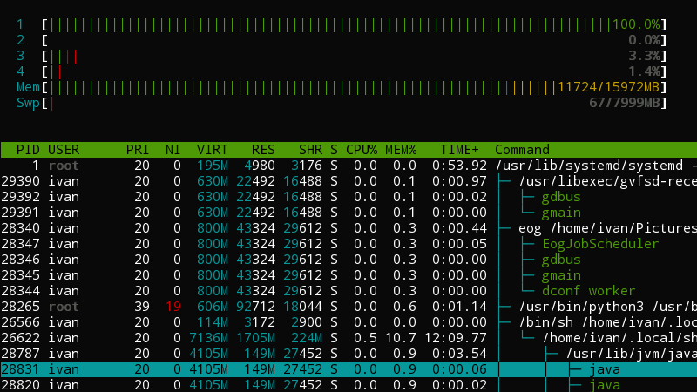
Aeron API. IdleStrategy

Slide 9
Aeron API. IdleStrategy
while (isRunning())
{
int received = subscription.poll(dataHandler, LIMIT);
idleStrategy.idle(received);
}
Notes:
Вот здесь вы должны мне задать вопрос

